Slide 1
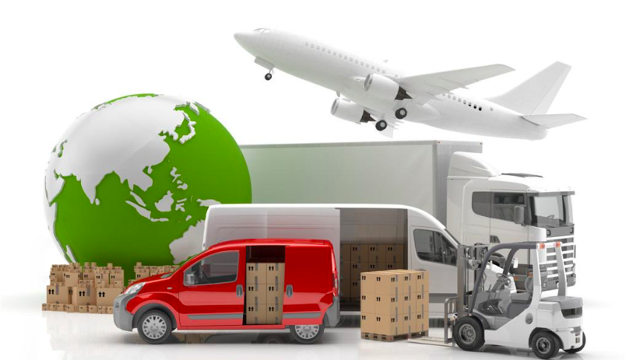

Final Assignment
Design and implementation of logistics management system
Zifeng Xu 001045590
Yutong Zhen 001557715
Jiajia Liu 001568540

Slide 2
CONTENTS
01
Design Background And Ideas
02
Demand Analysis
03
Diagram Information
04
FLow Chart of System Operation
05
Conclusion

Slide 3
01
Design Background And Ideas
Part

Slide 4
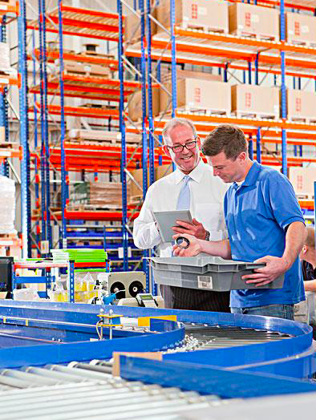
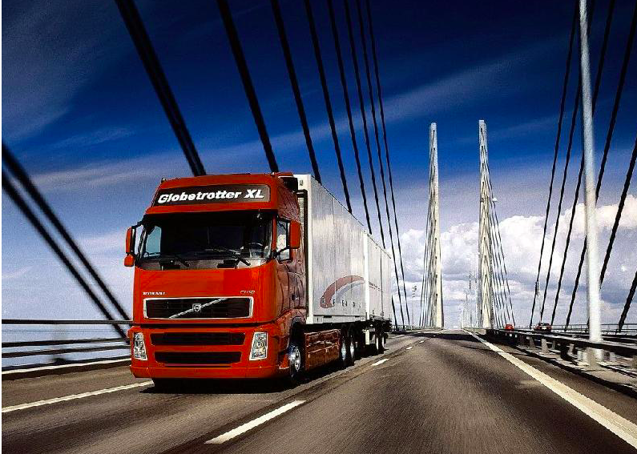
Design Background And Ideas
Background
Database to store all the business data of the company uniformly。
It can realize the unified storage and reading of data。
Achieve the logistics distribution of every link of resource sharing. In order to improve the efficiency of business processing
请替换文字内容
请替换文字内容，修改文字内容，也可以直接复制你的内容到此。请替换文字内容，修改文字内容，也可以直接复制你的内容到此。
Using the computer to manage the logistics enterprise information, to achieve information storage, transportation, vehicle scheduling management system, greatly improve the work efficiency, for the enterprise to create better benefits

Slide 5
02
Demand Analysis
Part

Slide 6
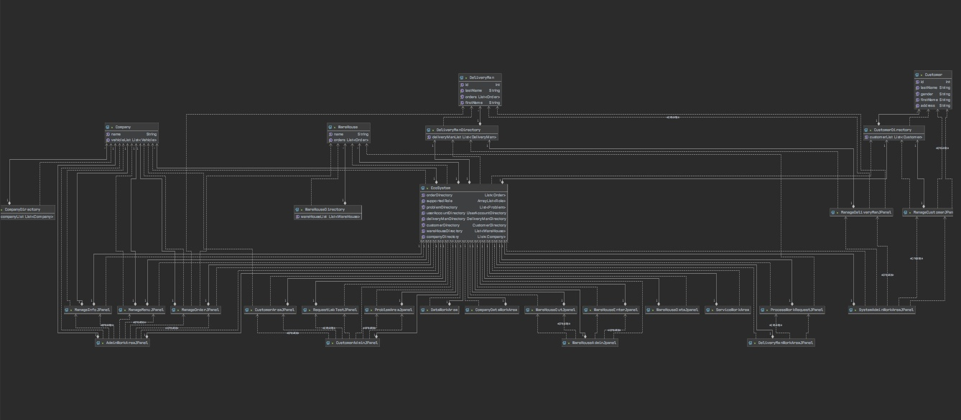
UML Diagram

Slide 7
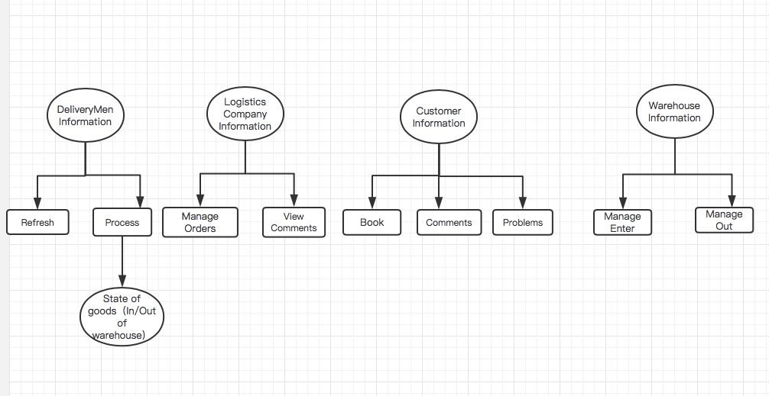
Demand Analysis
Users can register an account with their job number to log in to the system for business operations.
Mainly including Customer information management, DeliveryMan information management, Logistics Company information management and Warehouse Information.

Slide 8
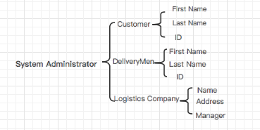
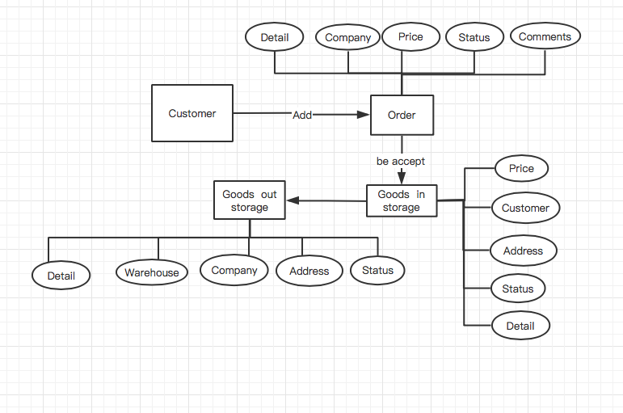
Model Instructions
Order management
Basic information management

Slide 9
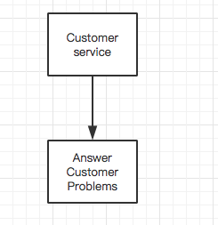
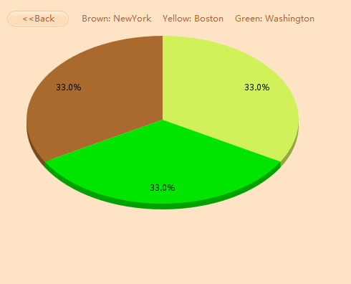
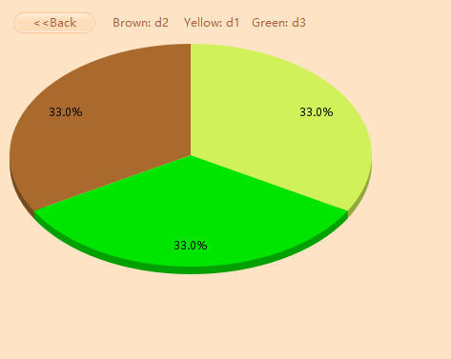
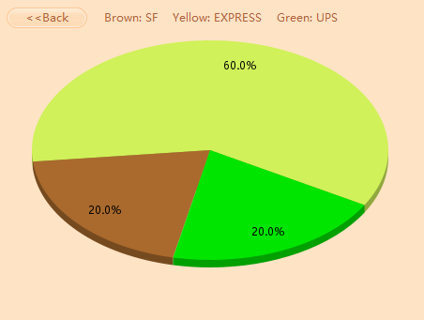
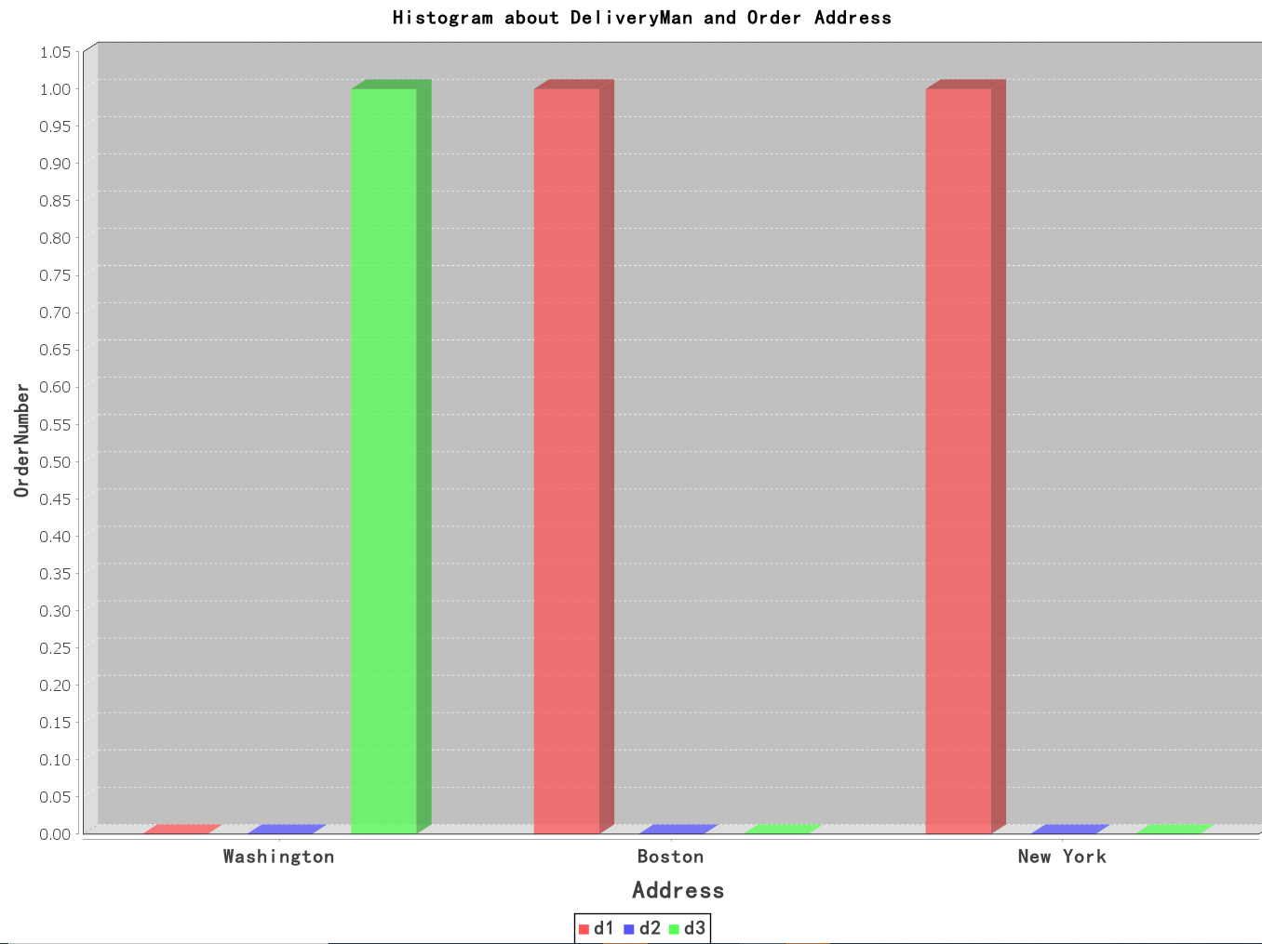
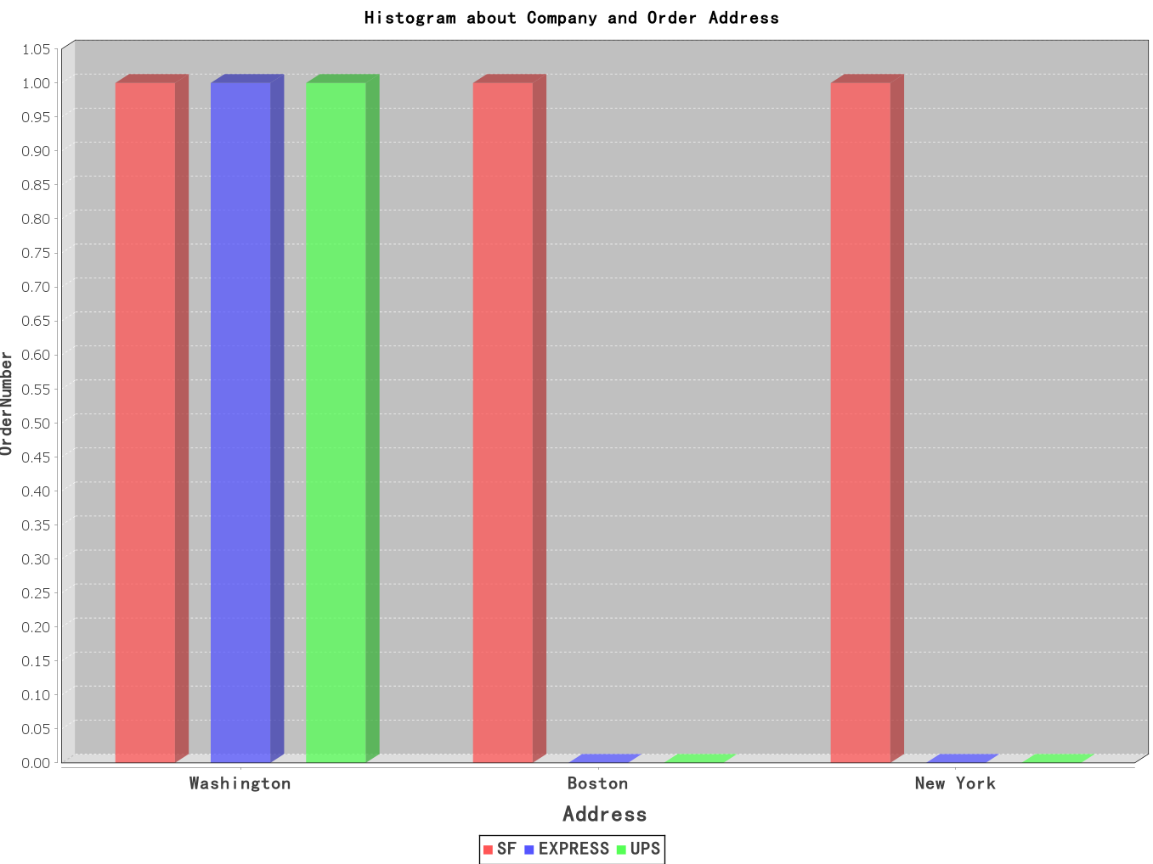
Model Instructions
Data Management
Answer Problems

Slide 10
03
Diagram Iinformation
Part

Slide 11
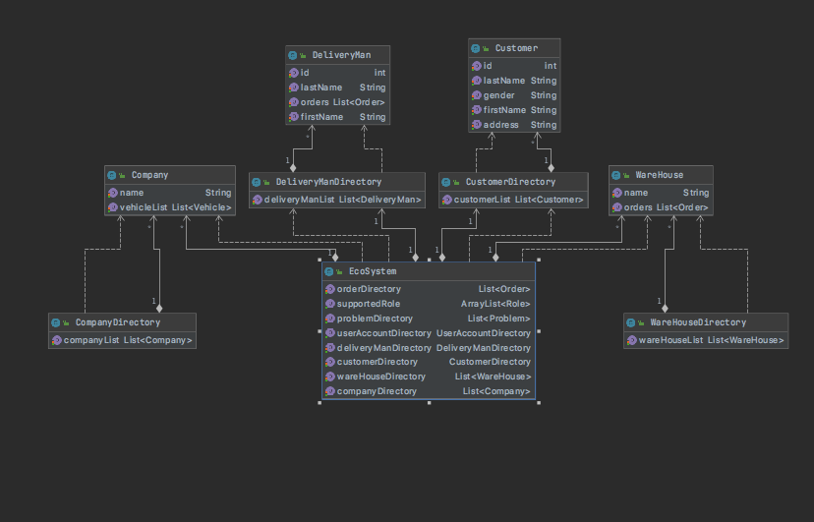
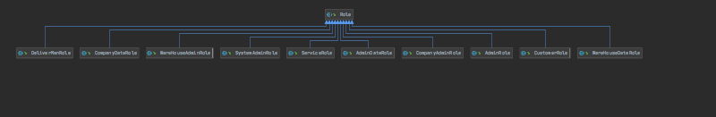
UML Diagram
System
点击请替换文字内容
请替换文字内容，添加相关标题，修改文字内容，也可以直接复制你的内容到此。
点击请替换文字内容
请替换文字内容，添加相关标题，修改文字内容，也可以直接复制你的内容到此。
Role

Slide 12
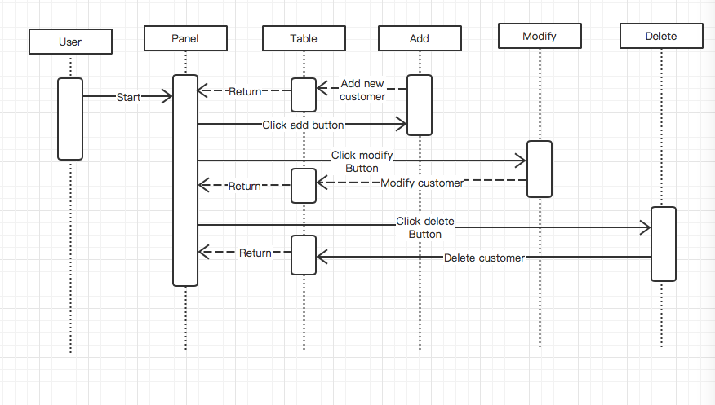
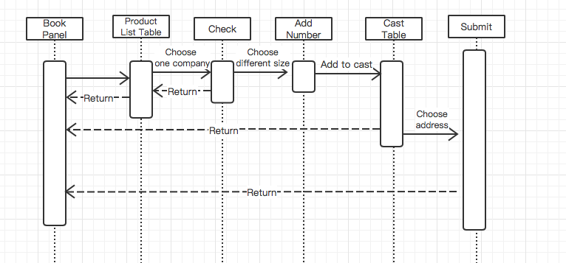
User Sequence Diagram
Customer Book Sequence
Customer Management Sequence

Slide 13
04
Flow Chart of System Operation
Part

Slide 14
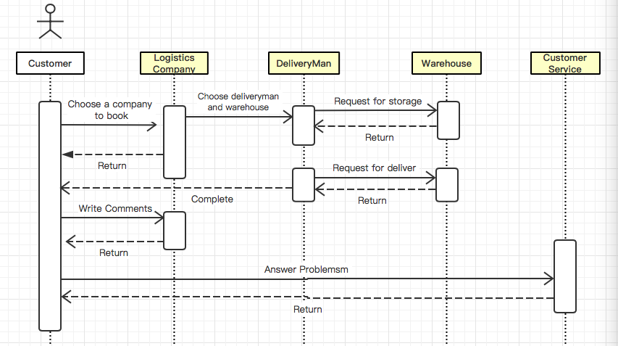
Flow Chart of System Operation

Slide 15
05
Conclusion
Part

Slide 16
Conclusion
How to expand global level
Solution
The mode of transportation is relatively simple（only for land）
Increase means of transportation.(including air, sea, and other means of transportation)
Client presentation platform is
only for laptops
Adjust different business terminals for the corresponding client display platform such as mobile phones,pads and other ways to access.

Slide 17
Thanks For Watching！

